Slide 1



GitHub Portfolio Presentation
Oracle 19c | PL/SQL | Java
Oracle Database 19c Enterprise Edition Production v. 19.3.0.0.0
Eclipse v. 2020-12 (4.18.0)
Oracle SQL Developer v. 20.4.1.407, Build 407.0006
SQL * Plus Release 19.0.0.0.0, v. 19.3.0.0.0
Presented by
David Watson (a.k.a Freestyle7)

Slide 2
Oracle | Java | GitHub Portfolio Presentation
Contact Information
David Watson (a.k.a Freestyle7)
djnsmith7@yahoo.com

Slide 3
Table of Contents
Introduction……………………………………………………………………………….………… 1.1
Education……………………………………………………………………………………..….…. 1.2
Project Objectives…………………………………………………………………………………..…. 1.3
PL/SQL Entity Tables List………………………………………………………………………………. 2.1 – 2.2
PL/SQL Entity Tables | SQL * Plus | Hospital_DB Database …………………………………………………….. 2.3 – 2.5
PL/SQL Entity Tables | SQL * Plus……………………………………………………………….……..… 3 – 18
PL/SQL Regression Model | Sales_Data…………………………………………………………………….. 19
PL/SQL Primary & Foreign Keys | SQL * Plus……………………………………………………………….. 20 - 21
PL/SQL Dynamic Stored Procedure | Dynamic Order Update | SQL Developer ………………………………..…..…. 22 - 23
PL/SQL Function | Net 30 Available Credit | SQL Developer…………………………………………………….. 24
Java | JDBC | Call PL/SQL Function | Net 30 Available Credit | Eclipse …………………………………………….. 25
Java | JDBC | Call PL/SQL Stored Procedure | Java PL/SQL Order | Eclipse………………………………………..... 26
Java | JDBC | Call PL/SQL Stored Procedure | Java PL/SQL Orders_Stat_Data | Eclipse………………………………… 27
Java | JDBC | Create PL/SQL Entity Table…………………………………………………………………… 28
Java | JDBC | Insert PL/SQL Data…………………………………………………………………………. 29
Java | JDBC | Alter Column | PL/SQL………………………………………………………………………. 30
Java | JDBC | Select PL/SQL Data | Output…………………………………………………………………... 31
Java | JDBC | Generate PL/SQL Foreign Keys………………………………………………………………... 32
PL/SQL Dynamic Stored Procedure | Mean | Median | Standard Deviation | SQL Developer……………………………… 33
PL/SQL AES192 Encryption | SQL Developer & SQL * Plus .…………………………………………………… 34 - 35
PL/SQL DBMS_Scheduler | SQL Developer & SQL * Plus ….…………………………………………………... 36 - 38
PL/SQL Package | Dynamic Order Update | SQL Developer & SQL * Plus..…………………………………………. 39 - 40

Slide 4
Database Slide Assignments
Database I: Oracle 19c – GitHub Project
Slide 2.1
Slides 8 – 27
Slides 33 – 40
Database II: Hospital_DB
Slides 2.2 – 2.5
Slides 28 - 32

Slide 5
Introduction 1.1
My path to programming began in high school in Salinas, California where I developed an interest in Red Hat Linux as a hobbyist. Fast-forward to 2019, where I decided to transition from a successful sales and marketing Account Manager with 10+ years of experience to an Oracle developer. I decided to make this transition because programming and working as a technologist is where my real passion resides.
I am building my PL/SQL and Java portfolio on GitHub so that I can showcase my skill sets and experience. I intend to utilize this opportunity to build upon this platform as I progress and expand my knowledge and discoveries.
My primary objective is to create an opportunity that will result in landing a position as an Oracle developer. I intend to create that opportunity by accurately presenting my Oracle 19c PL/SQL and Java projects where I have created two databases with fictitious data. I have designed and built queries and components that draw and execute data from those databases. The following is a list of queries and components that are presented and demonstrated within these projects: stored procedures, functions, data encryption, DBMS tools, a package, and Java JDBC components.

Slide 6
Education 1.2
I will graduate from Mission College in Spring 2021 with a an Associate of Arts in Communication Studies and a concentration in programming and a respectable GPA. My coursework included Oracle 12c, 19c, PL/SQL, Microsoft T-SQL and Python. As a result, I earned the Computer Information Systems Certificate of Proficiency.
Since I attended both Mission College and West Valley College, I was invited to join each of their Honors programs. If my full-time work schedule had permitted, I would have accepted their invitations. I also made the Dean’s list.
I decided to continue my coursework and research by investing in the following programming literature: ‘Oracle PL/SQL Programming, 6th ed.’ by Steven Feuerstein, ‘Oracle Database 12c: The Complete Reference’ by Bob Bryla, ‘Oracle Database 12c: SQL’ by Jason Price, ‘Oracle PL/SQL by Example: 5th ed.’ by Benjamin Rosenzweig, ‘Java: A Beginner’s Guide: 8th ed.’, and ‘Java: The Complete Reference: 11th ed.’ by Herbert Schildt, each of which provides focused concentrations, emphasis, and extensive coverage on the components presented within this project.

Slide 7
Project Objectives 1.3
My objectives for this project are as follows:
1. Demonstrate my PL/SQL abilities within Oracle 19c, SQL Developer, SQL * Plus, Eclipse, and Java environments.
2. Create a framework that showcases my skill sets within a structured layout that includes tables, primary and foreign keys, a dynamic stored procedure, a function, AES 192 encryption, a DBMS_Scheduler, a package, and a statistical data snapshot with mean, median, and standard deviation data.
3. Create a professional portfolio on GitHub that will result in new Oracle development opportunities.
4. Build upon my professional portfolio so that others with similar interests and career aspirations may learn from my skill sets, endeavors, and success in the future.
Continue a career-long path of higher education and create a platform where I can share and exchange new discoveries, ideas, and
technologies.

Slide 8
Entity Tables | Database I | Oracle 19c – GitHub Project 2.1
Leads
Catalog
Catalog_Class
Inventory
Accounts
Orders
Dyn_Order_Upd
Java_PL_SQL_Ord
Payments
Net_30
Net_30_Info
Credit_Cards
Bank_Accounts
Shipments
Employees
Sales Data

Slide 9
Entity Tables | Database II | Hospital_DB 2.2
Diagnoses
Doctors
Hospitals
Invoices
Patients
Products
Transactions

Slide 10
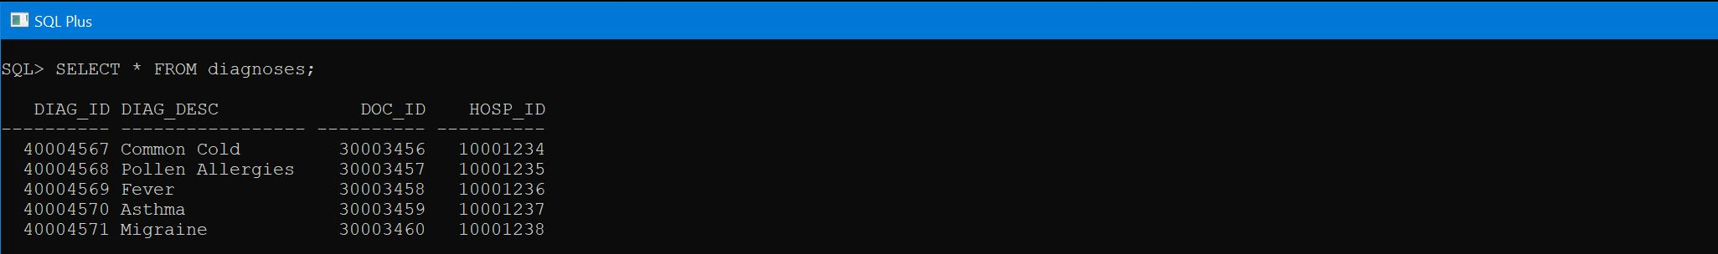
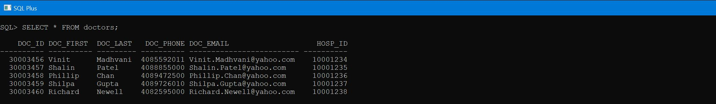
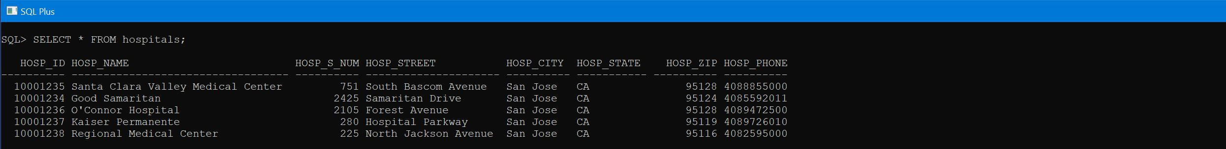
Entity Tables | Hospital_DB | Diagnoses | Doctors | Hospitals 2.3

Slide 11
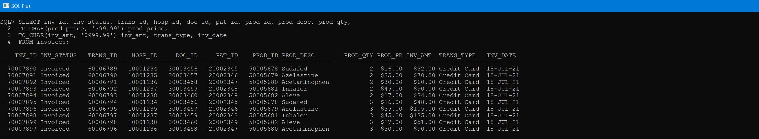
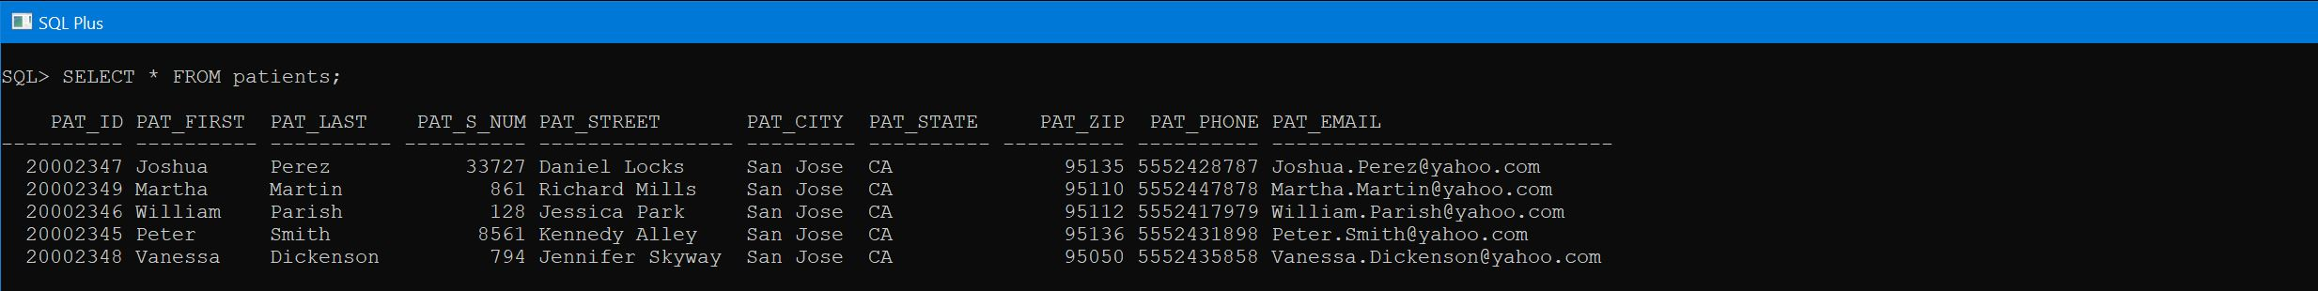
Entity Tables | Hospital_DB | Invoices | Patients 2.4

Slide 12
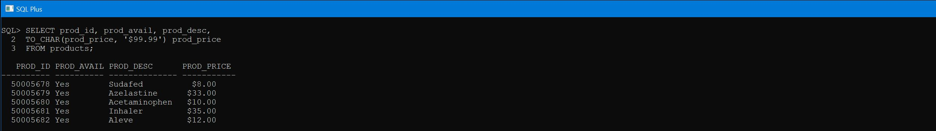
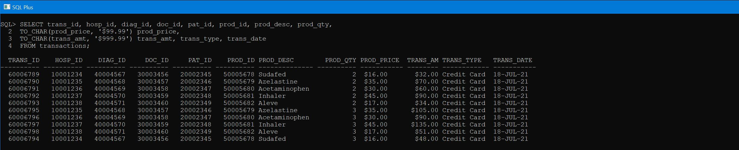
Entity Tables | Hospital_DB | Products | Transactions 2.5

Slide 13
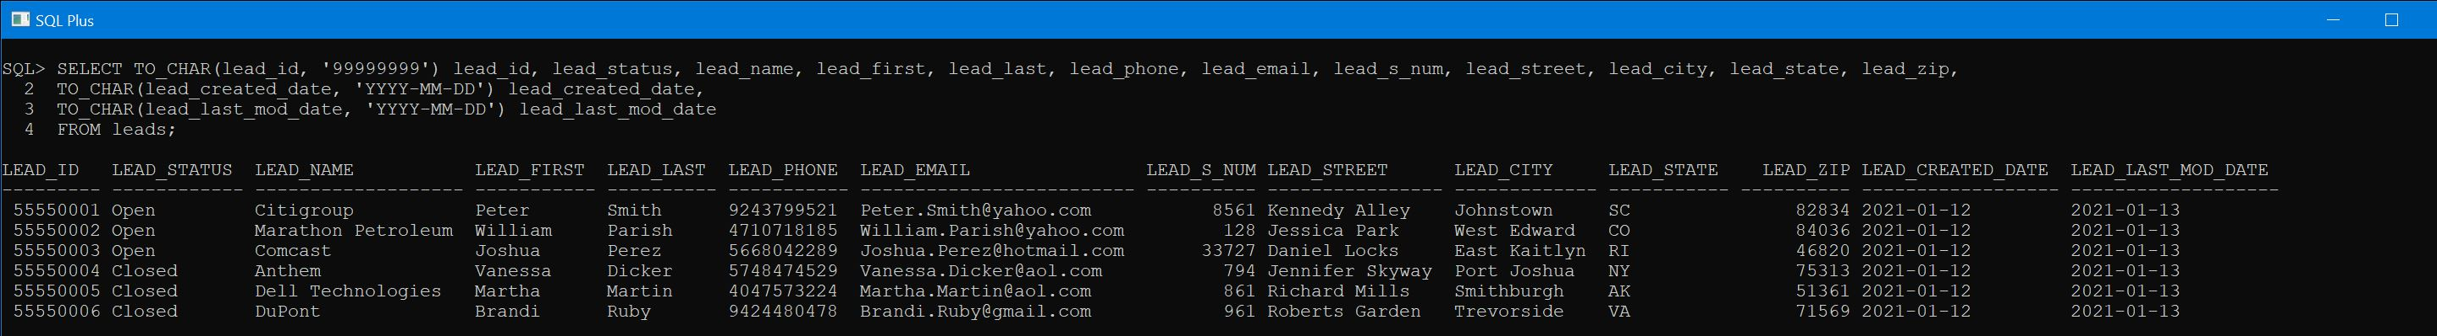
Entity Tables | Leads 3

Slide 14
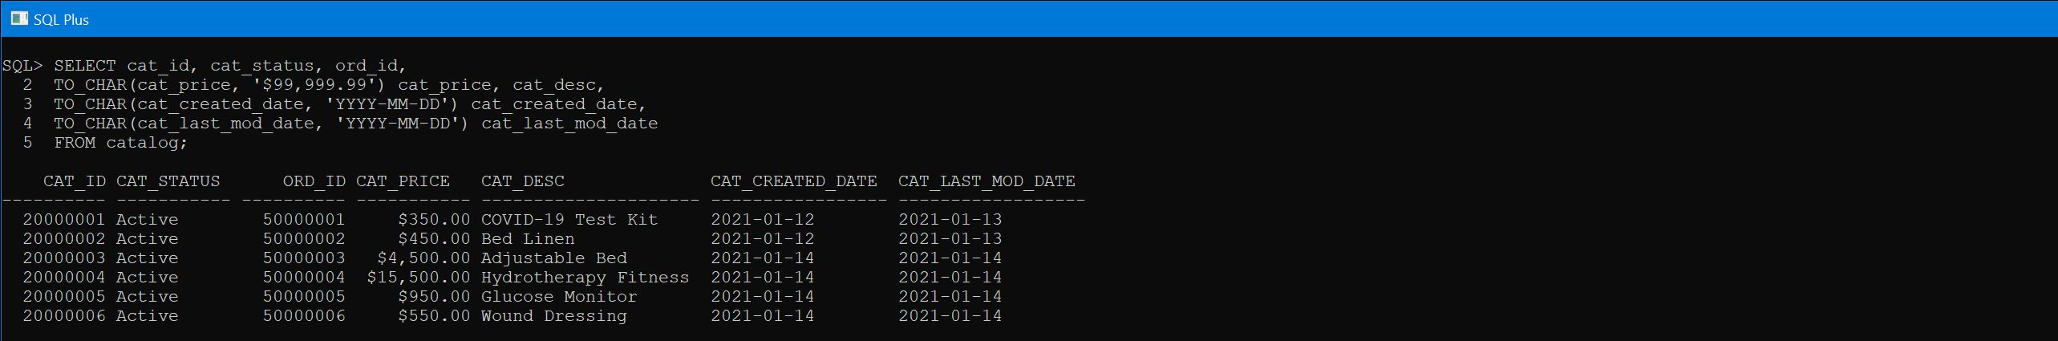
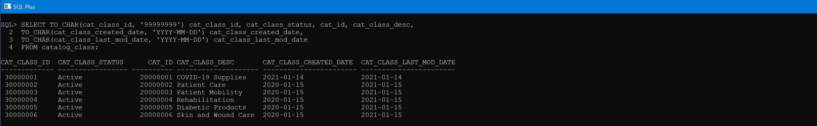
Entity Tables | Leads | Catalog | Catalog_Class 3, 4, 5

Slide 15
Entity Tables | Catalog 4

Slide 16
Entity Tables | Catalog_Class 5

Slide 17
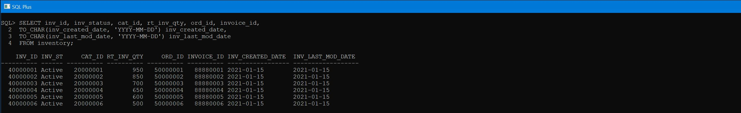
Entity Tables | Inventory 6

Slide 18
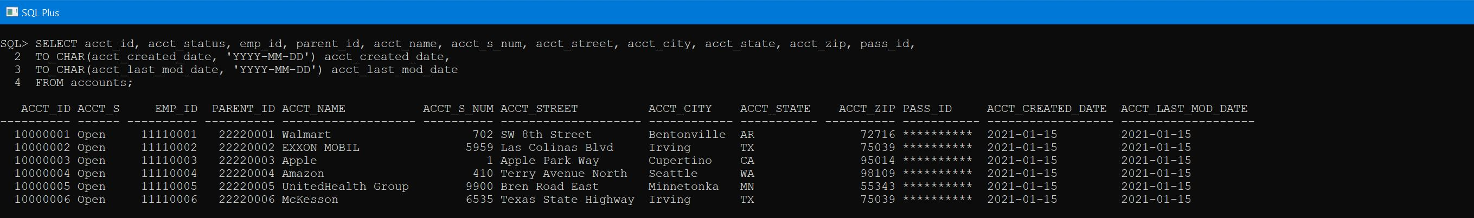
Entity Tables | Inventory | Accounts 6, 7

Slide 19
Entity Tables | Accounts 7

Slide 20
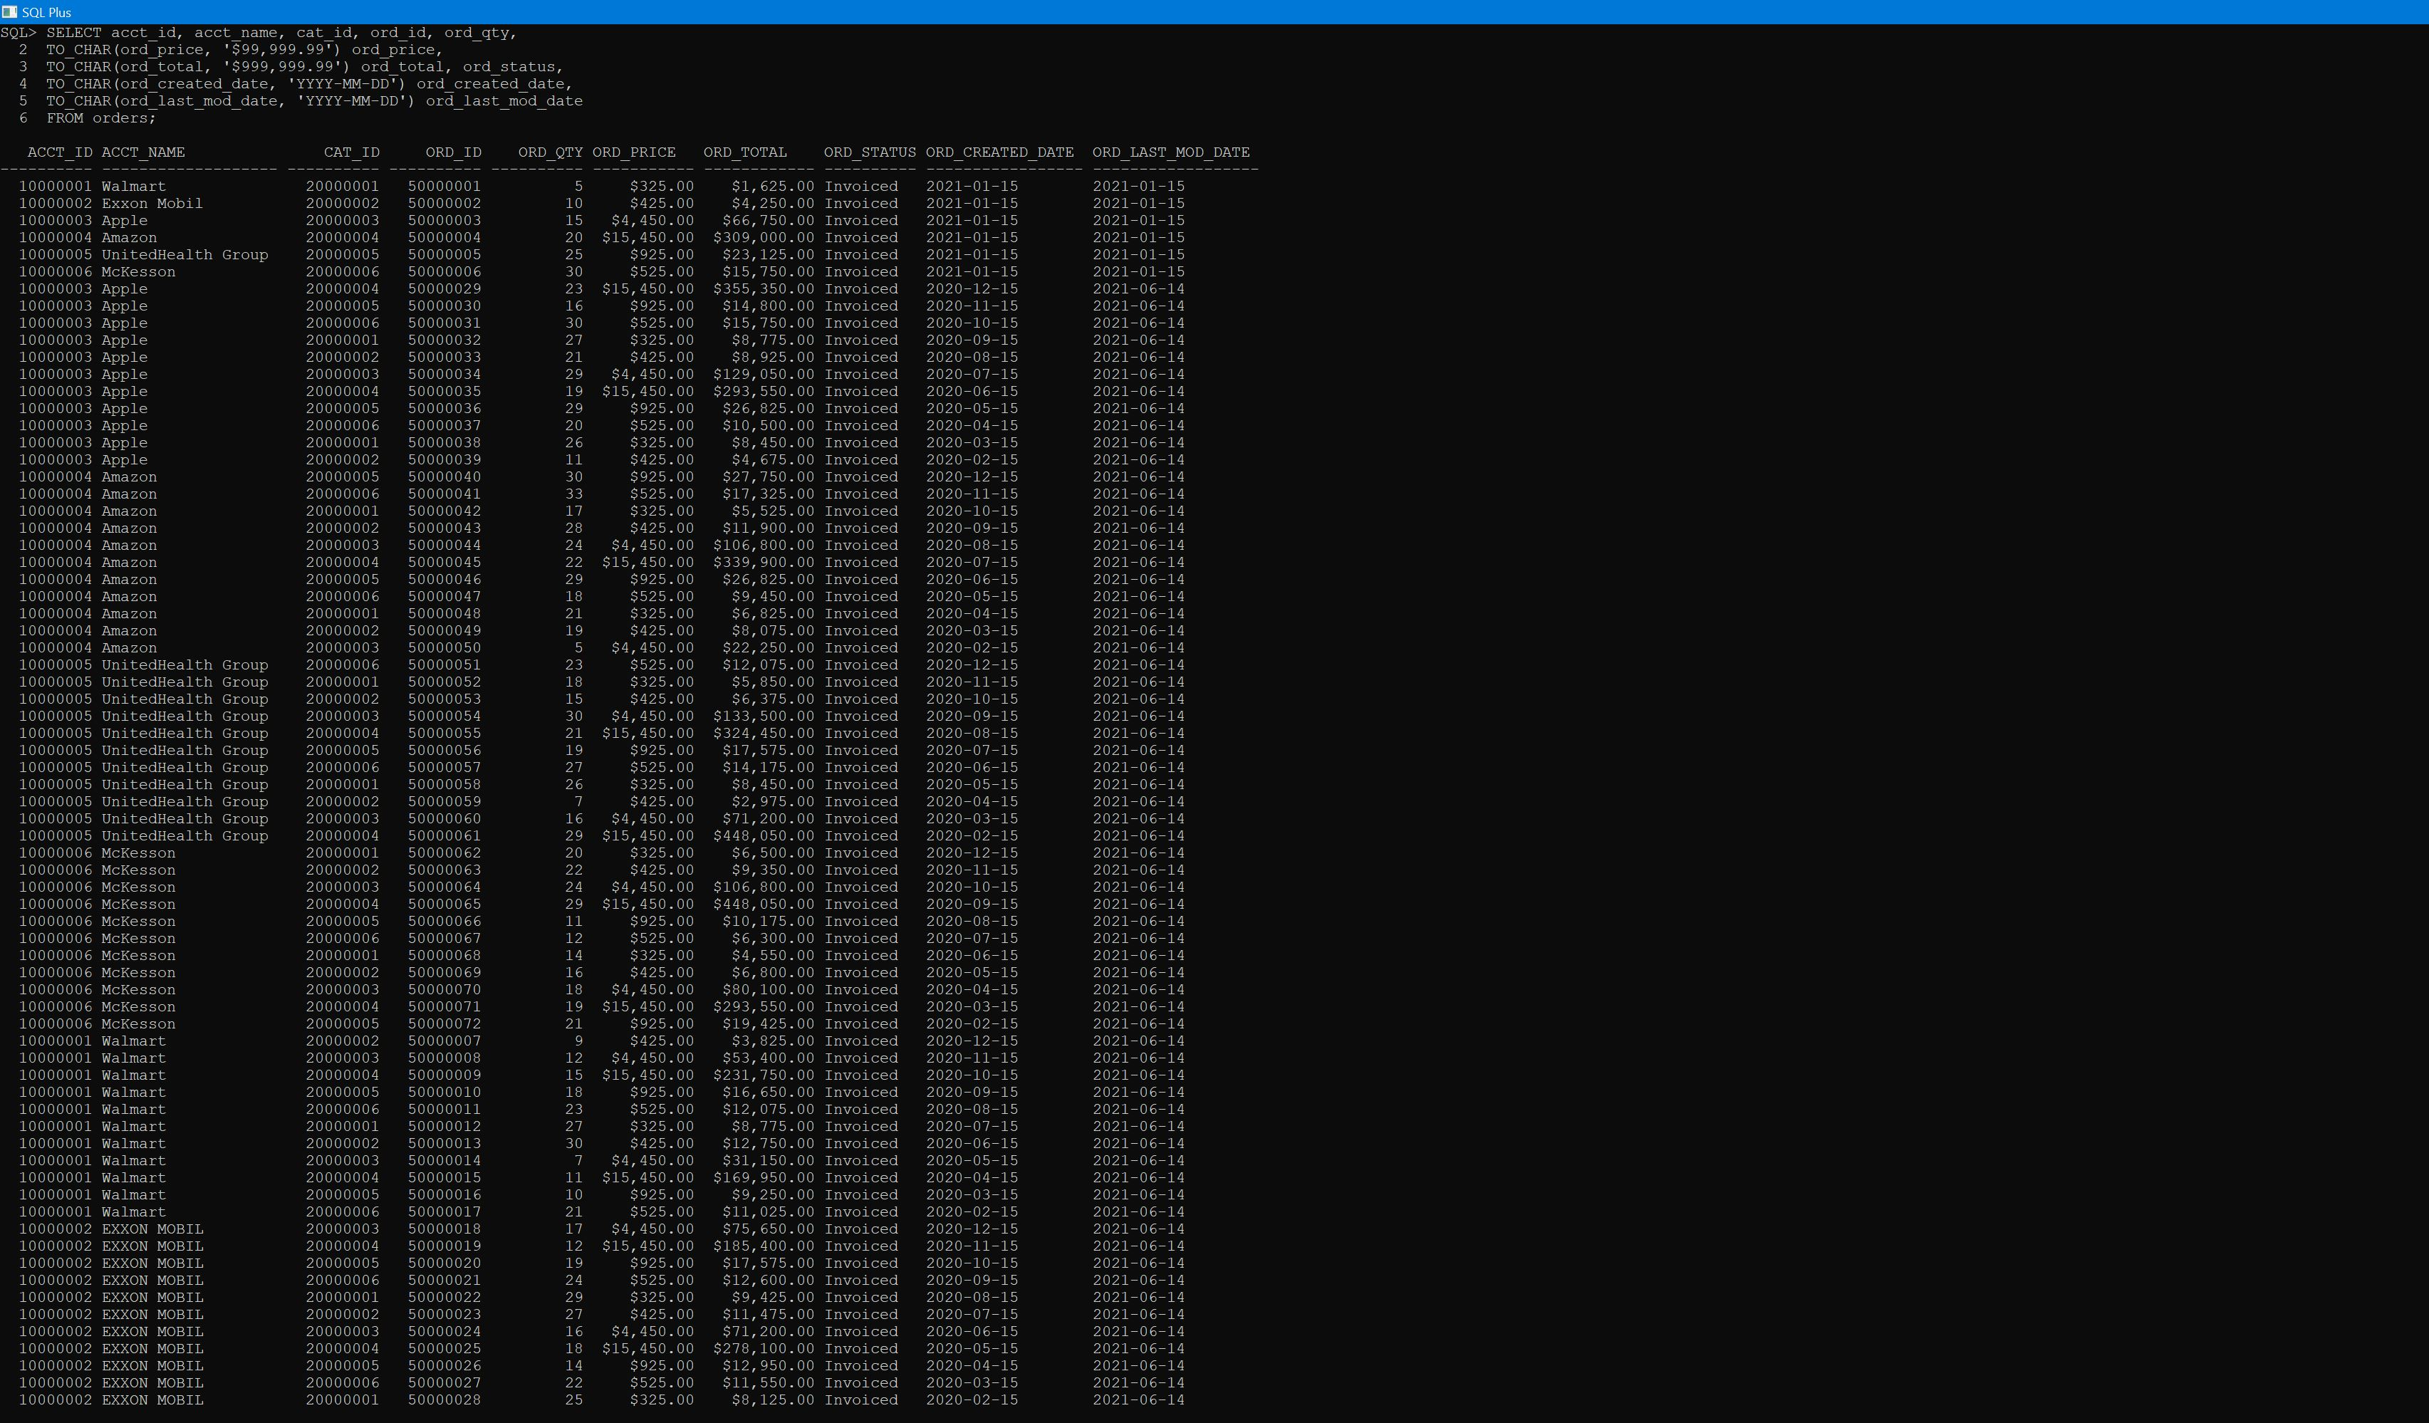
Entity Tables | Orders 8

Slide 21
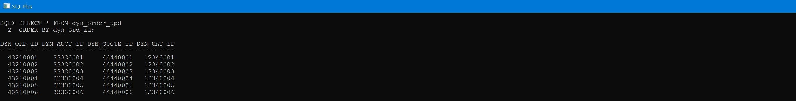
Entity Tables | Dyn_Order_Upd 9

Slide 22
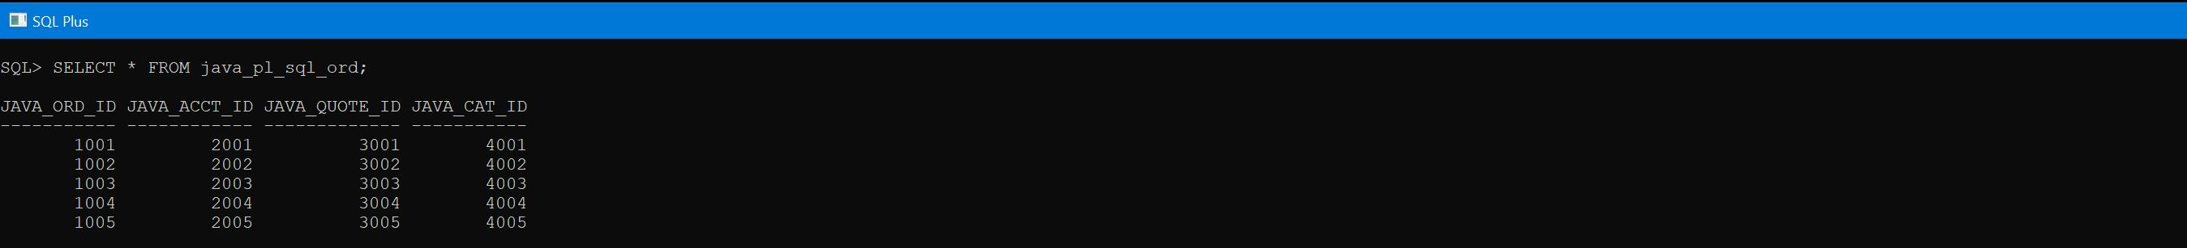
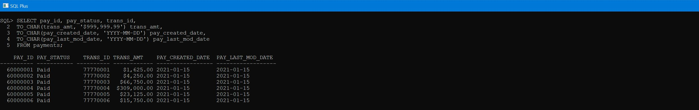
Entity Tables | Dyn_Order_Upd | Java_PL_SQL_Ord | Payments 9, 10, 11

Slide 23
Entity Tables | Java_PL_SQL_Ord 10

Slide 24
Entity Tables | Payments 11

Slide 25
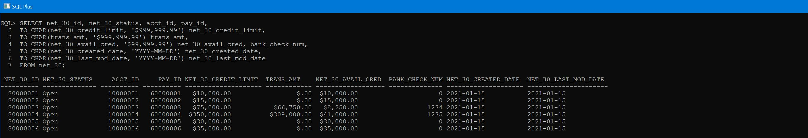
Entity Tables | Net_30 12

Slide 26
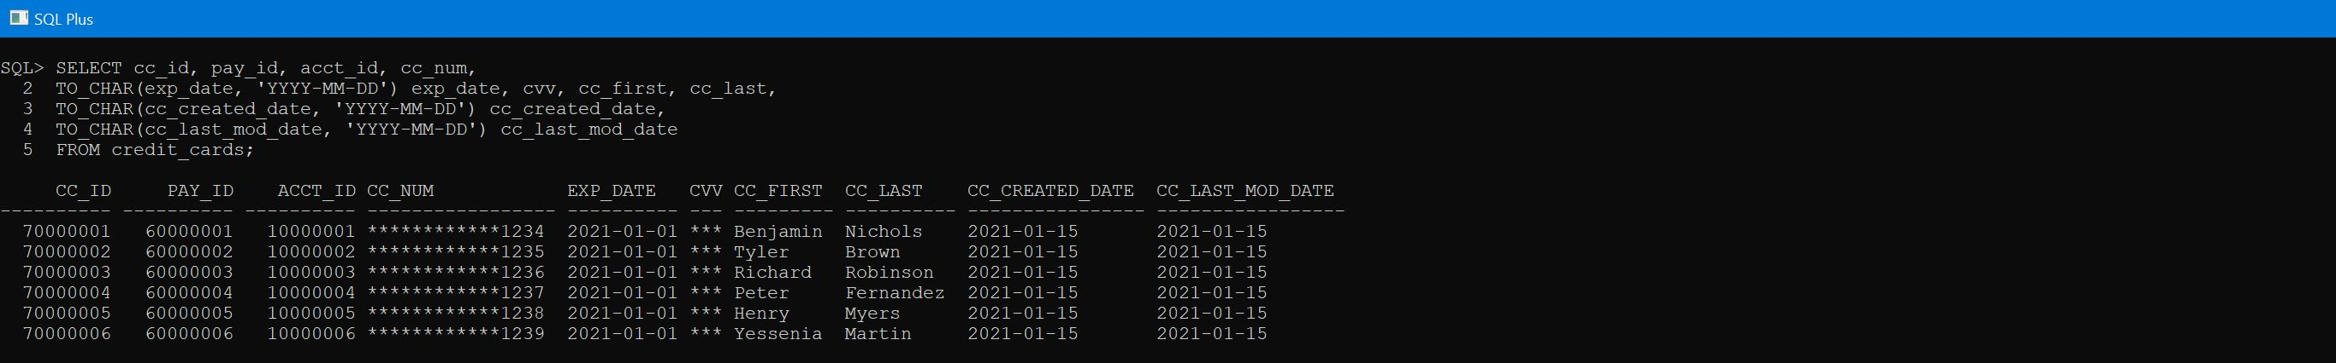
Entity Tables | Net_30 | Net_30_Info _Credit_Cards 12, 13, 14

Slide 27
Entity Tables | Net_30_Info 13

Slide 28
Entity Tables | Credit_Cards 14

Slide 29
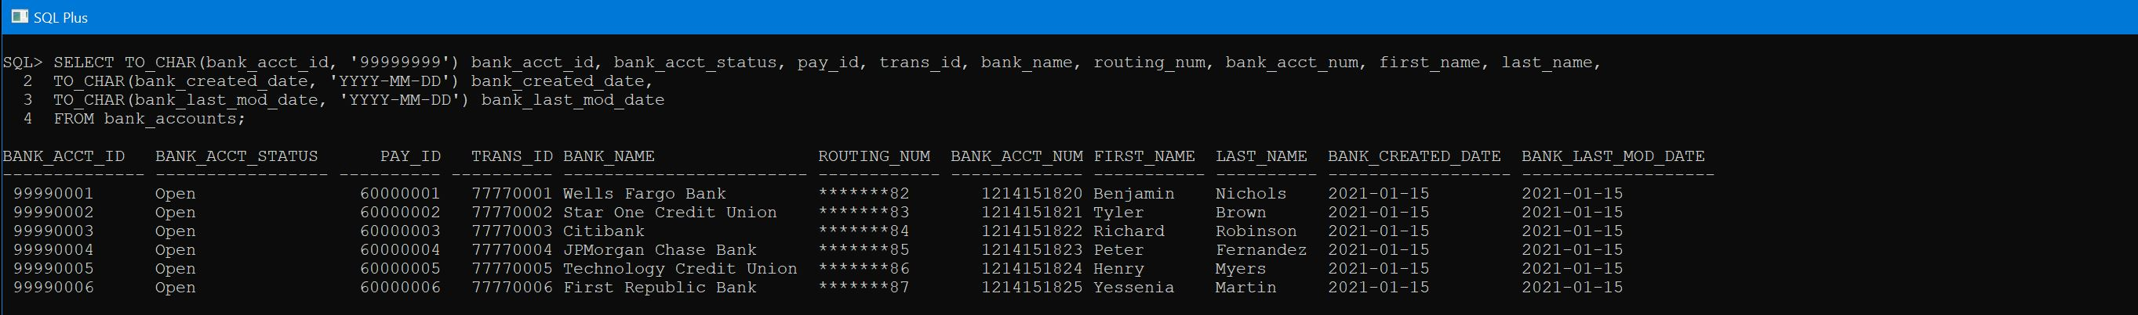
Entity Tables | Bank_Accounts 15

Slide 30
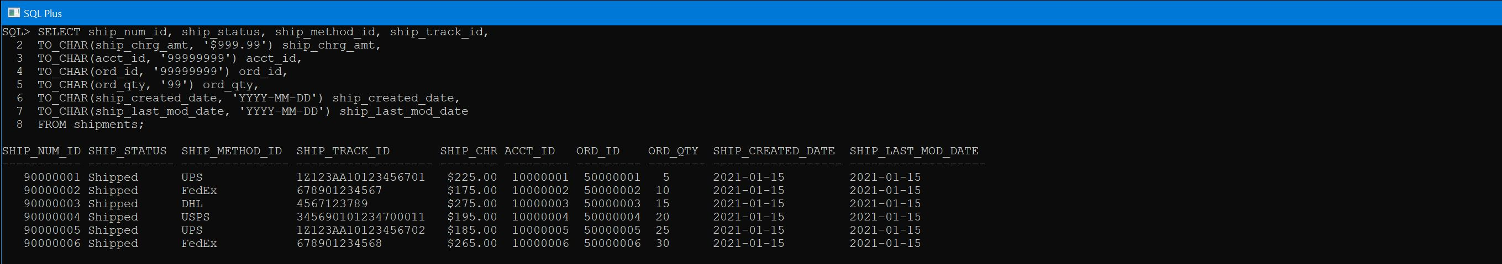
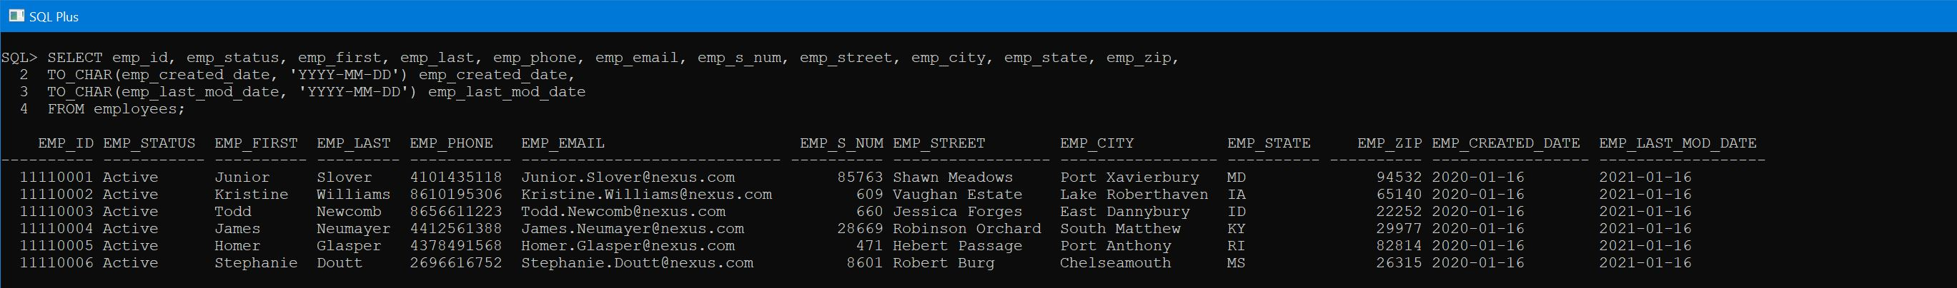
Entity Tables | Bank_Accounts | Shipments | Employees 15, 16, 17

Slide 31
Entity Tables | Shipments 16

Slide 32
Entity Tables | Employees 17

Slide 33
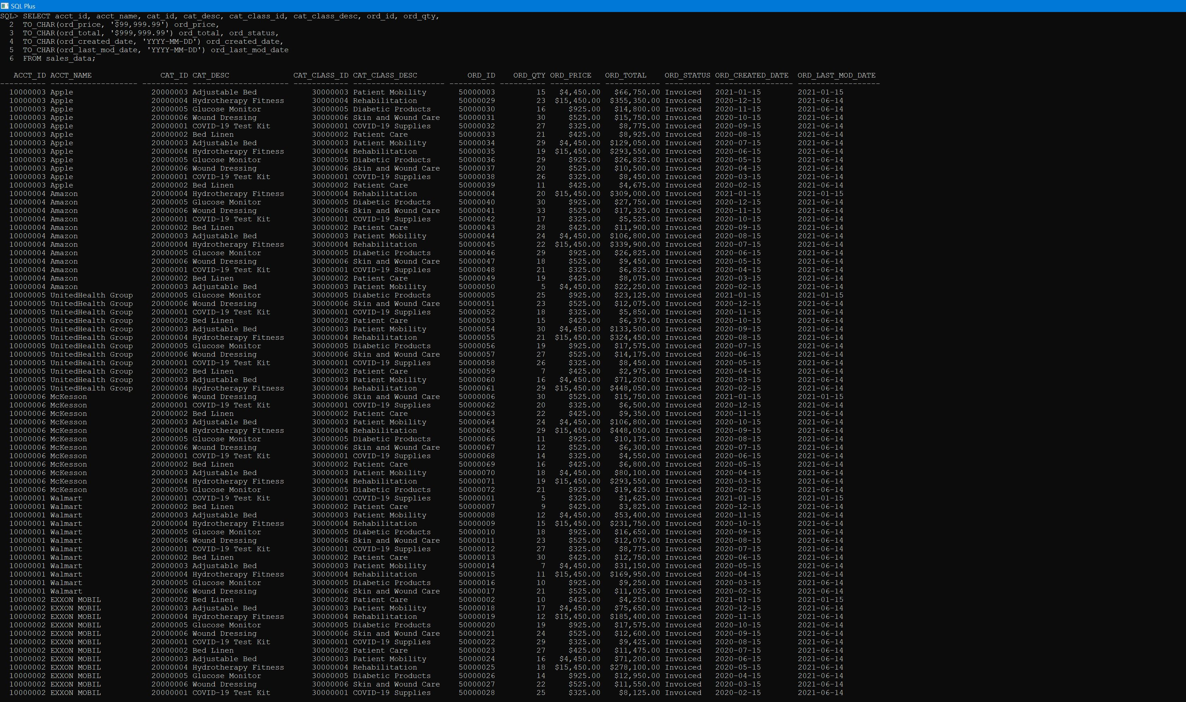
Entity Tables | Sales_Data 18

Slide 34
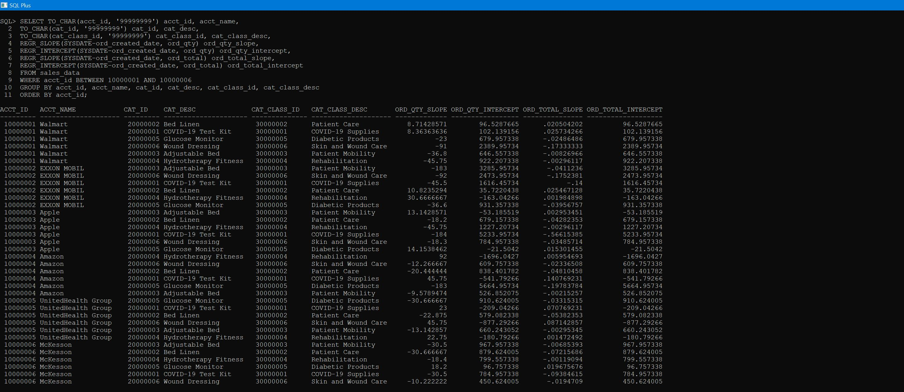
PL/SQL | Regression Model | Sales_Data 19

Slide 35
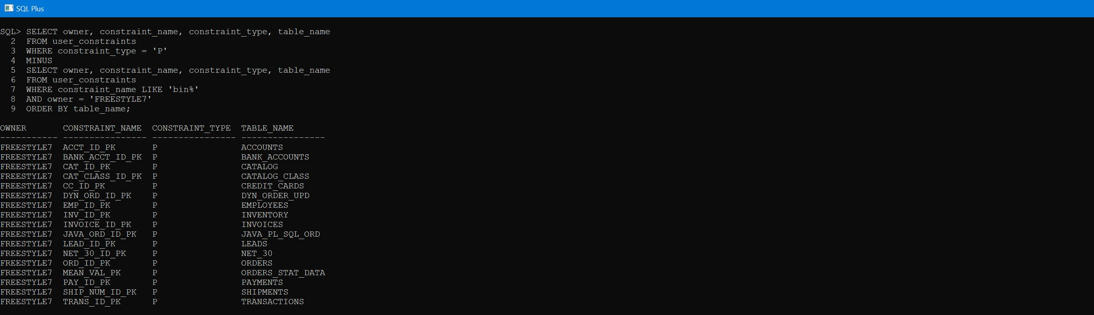
PL/SQL | Primary Keys (continued) 20

Slide 36
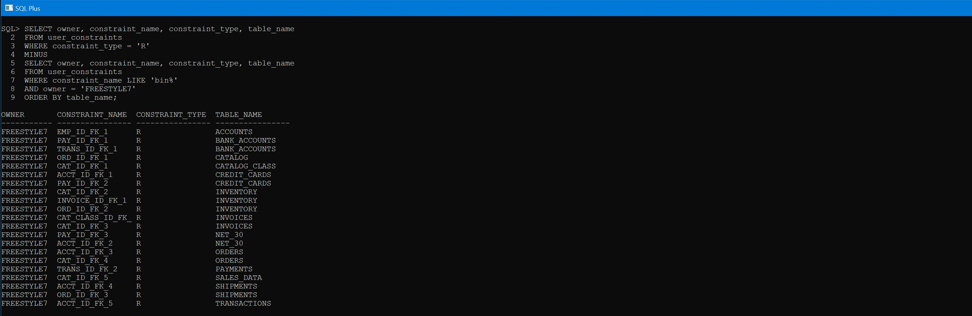
PL/SQL | Foreign Keys 21

Slide 37
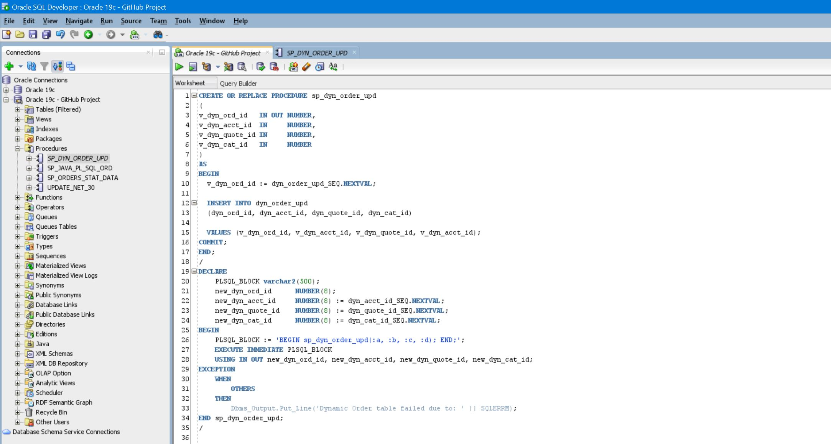
PL/SQL | Dynamic Stored Procedure | Dynamic Order Update (continued) 22

Slide 38
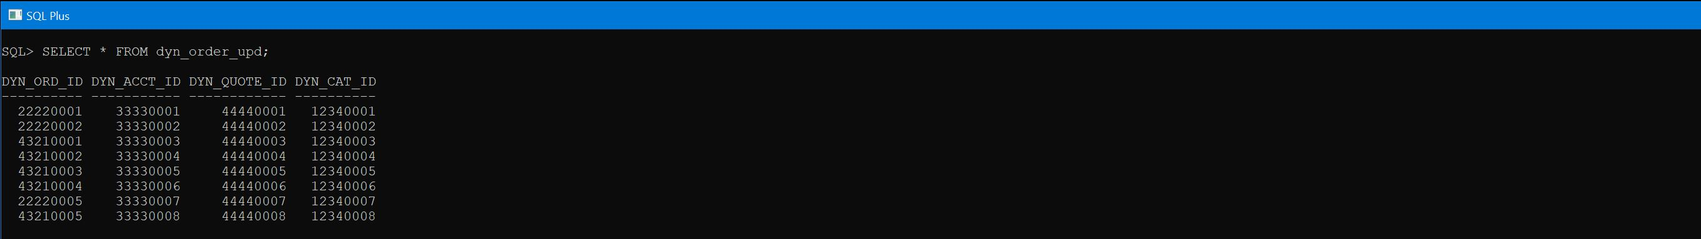
PL/SQL | Dynamic Stored Procedure | Dynamic Order Update | Output 23

Slide 39
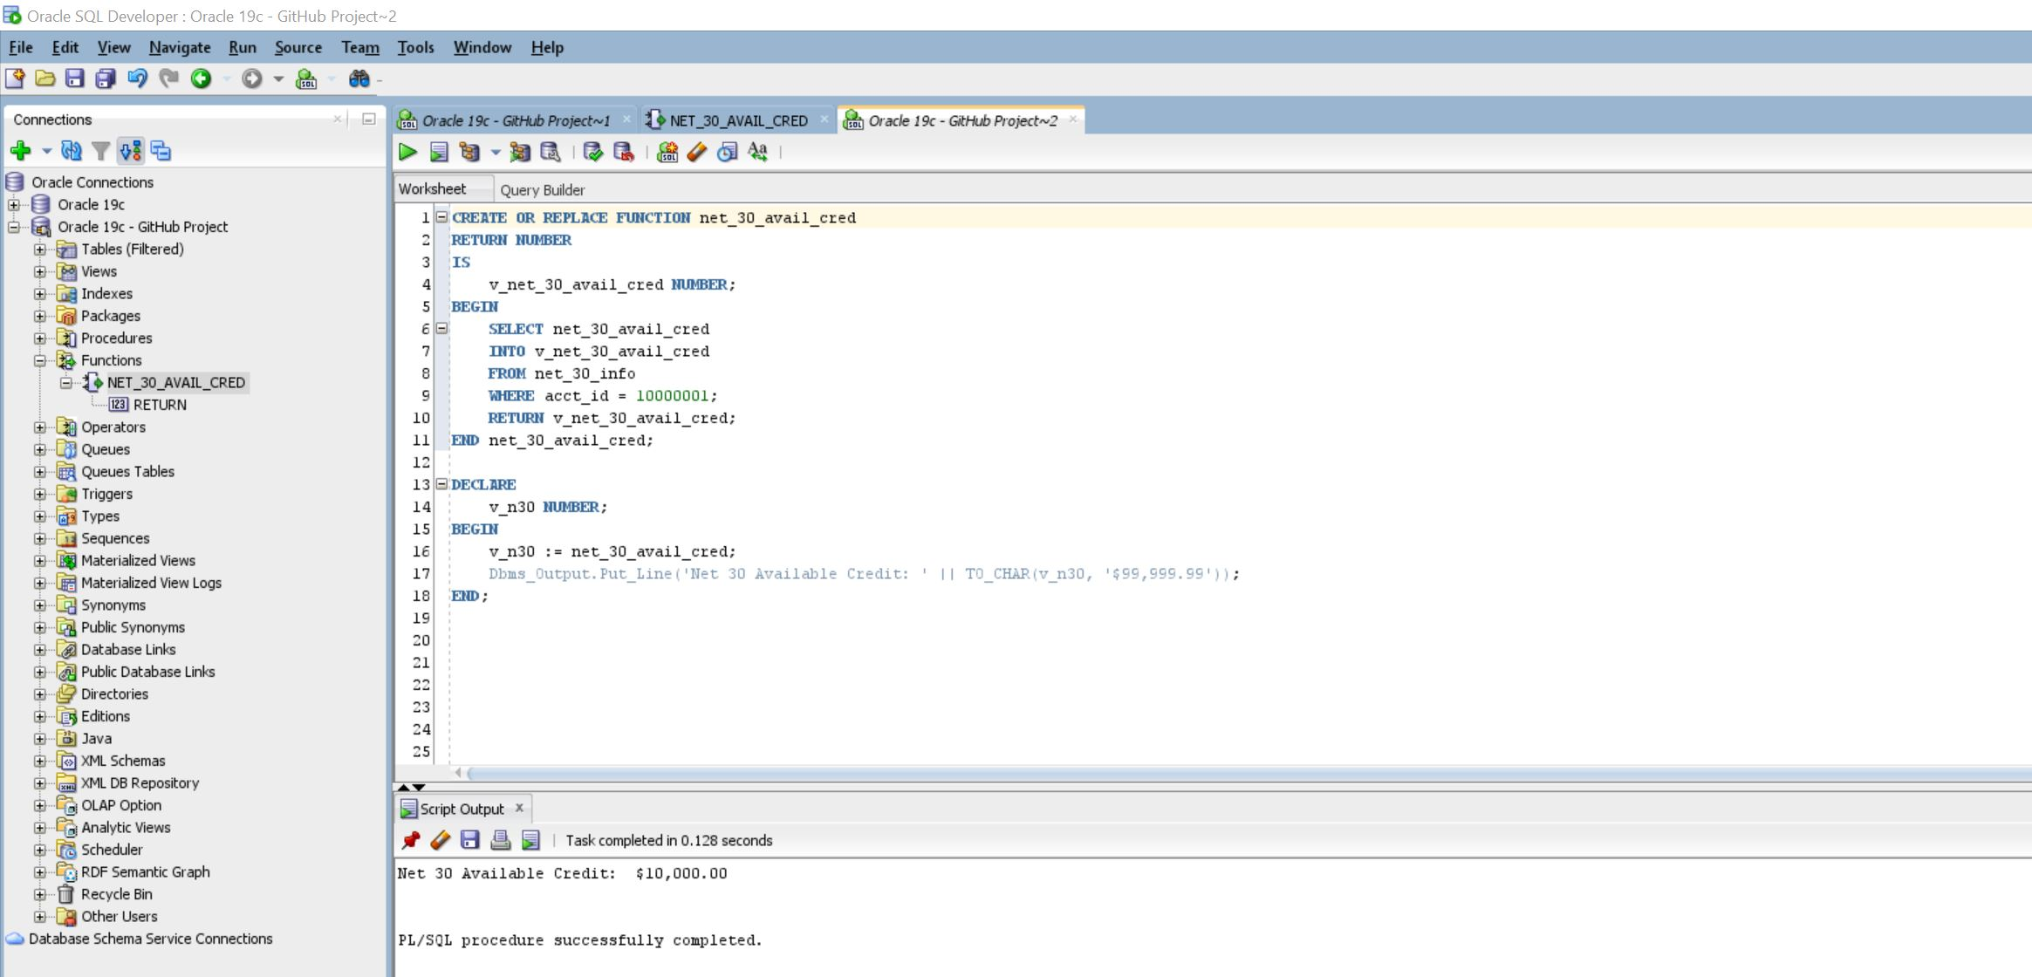
PL/SQL Function | Net 30 Available Credit 24

Slide 40
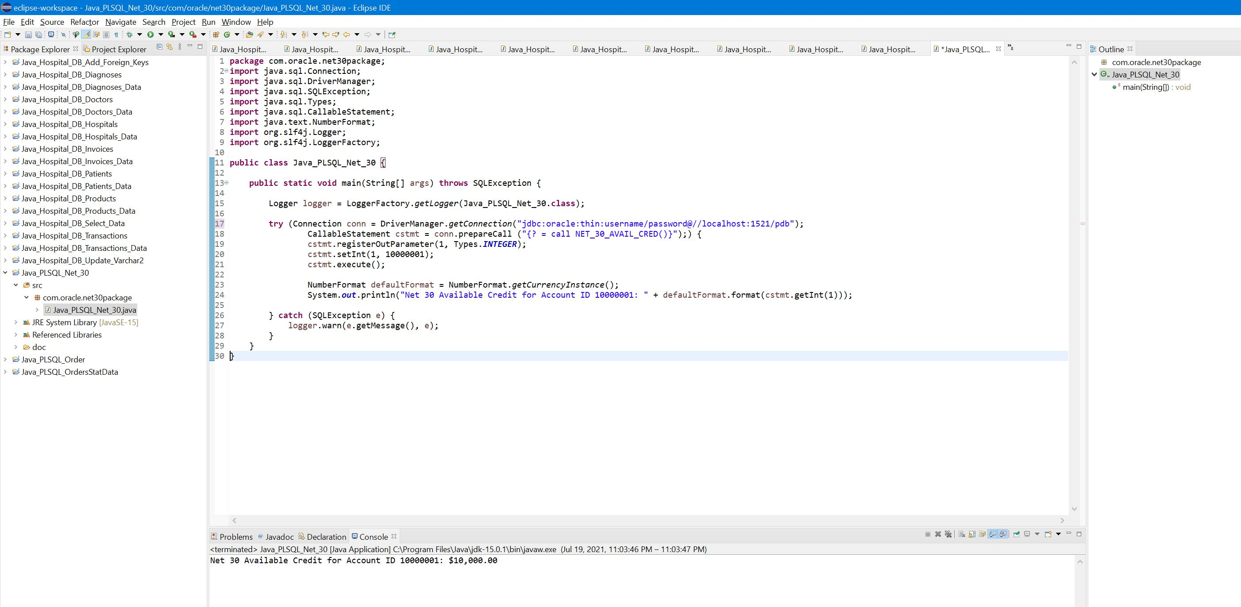
Java | JDBC | Call PL/SQL Function | Net 30 Available Credit 25

Slide 41
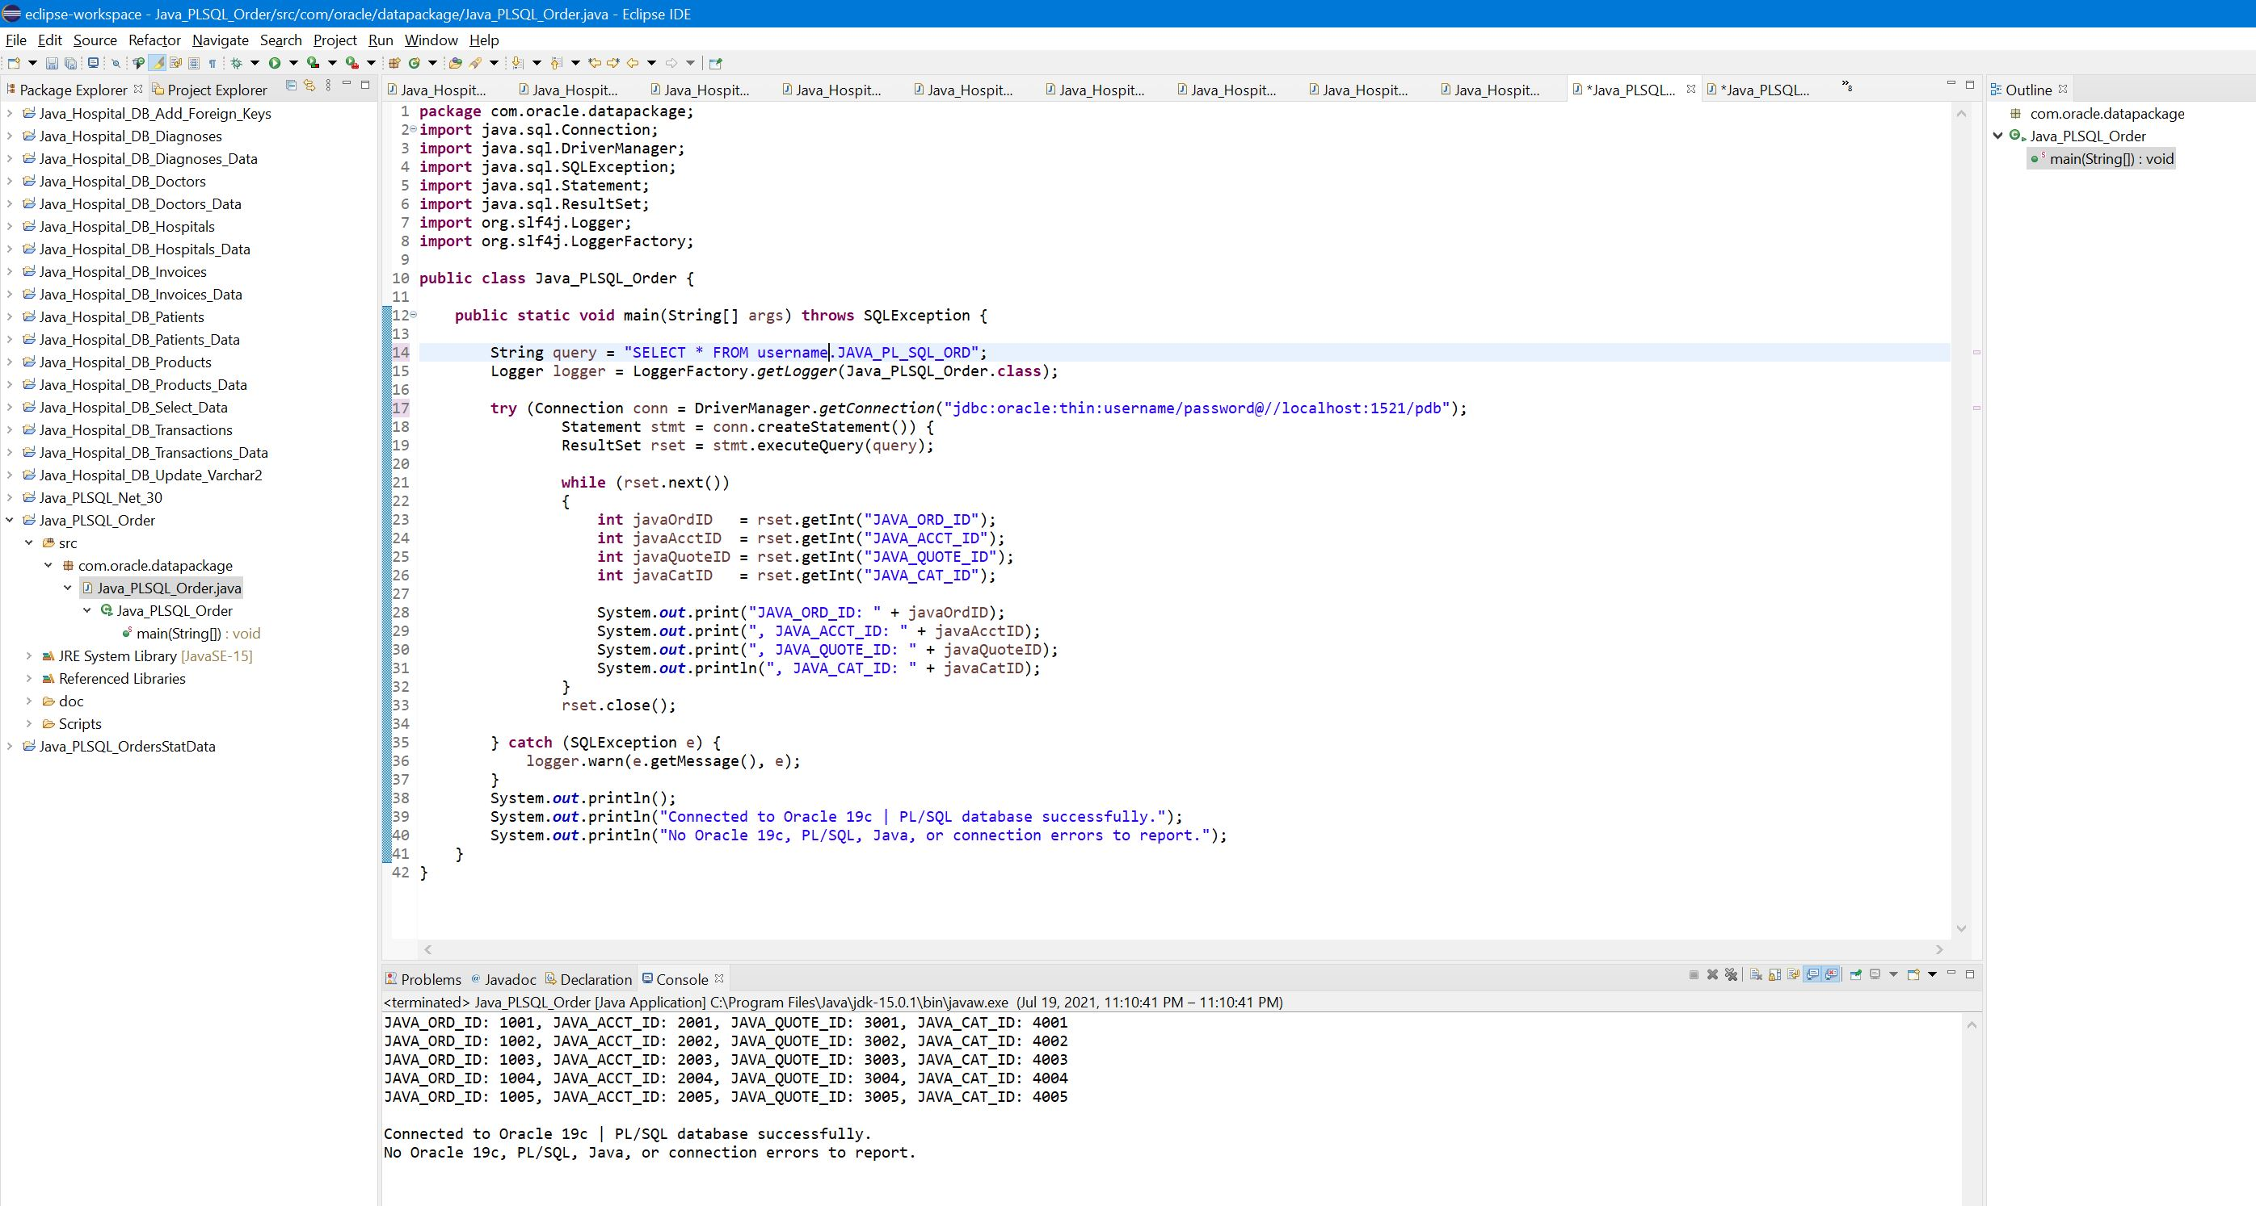
Java | JDBC | Call PL/SQL Stored Procedure | Java PL/SQL Order 26

Slide 42
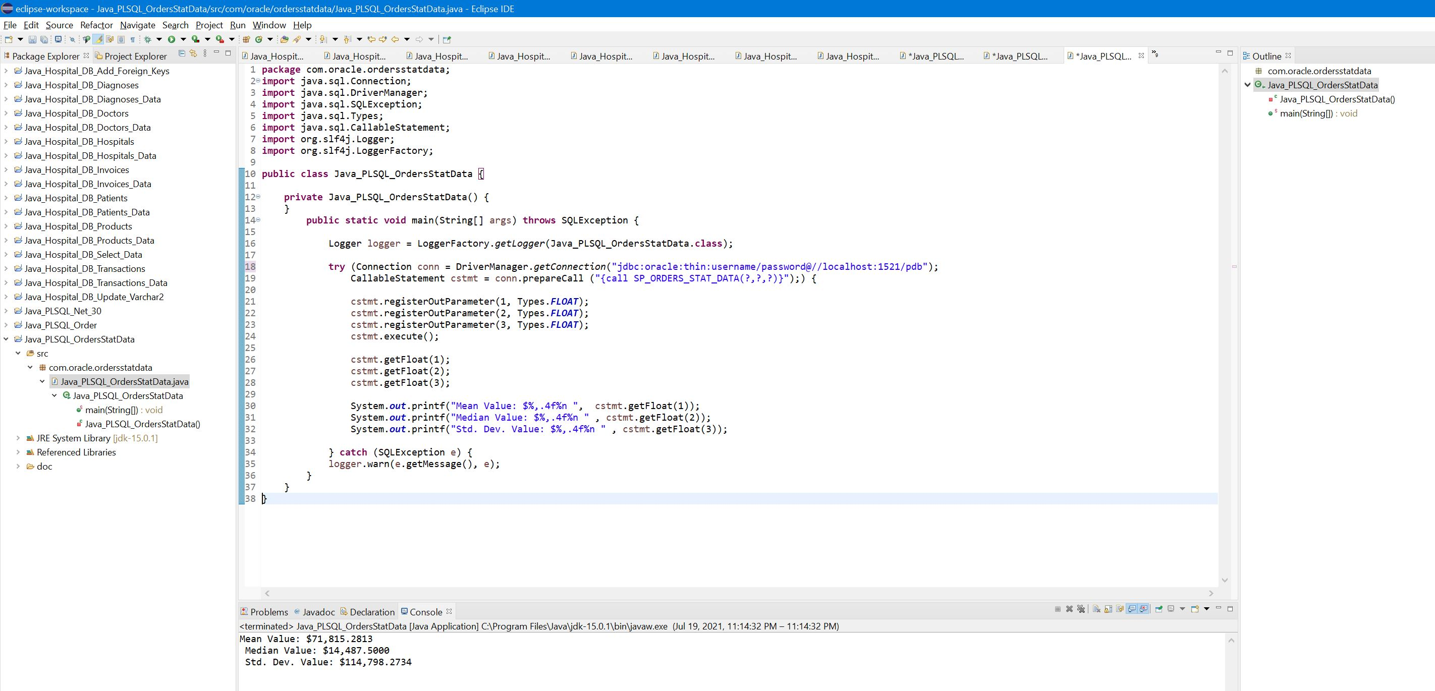
Java | JDBC | Call PL/SQL Stored Procedure | Java PL/SQL Orders_Stat_Data 27

Slide 43
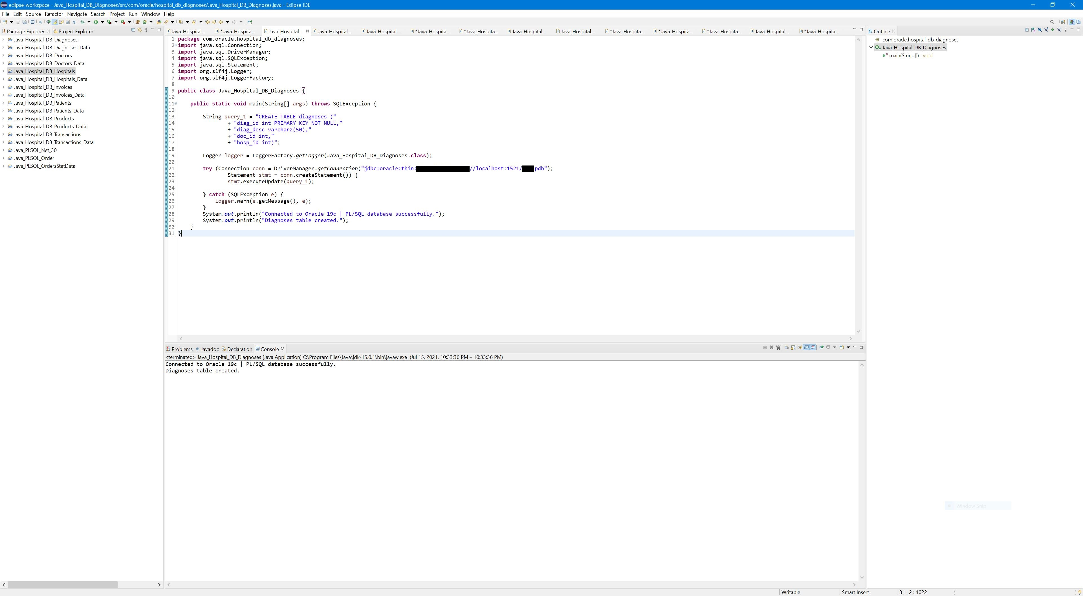
Java | JDBC | Create PL/SQL Entity Table 28

Slide 44
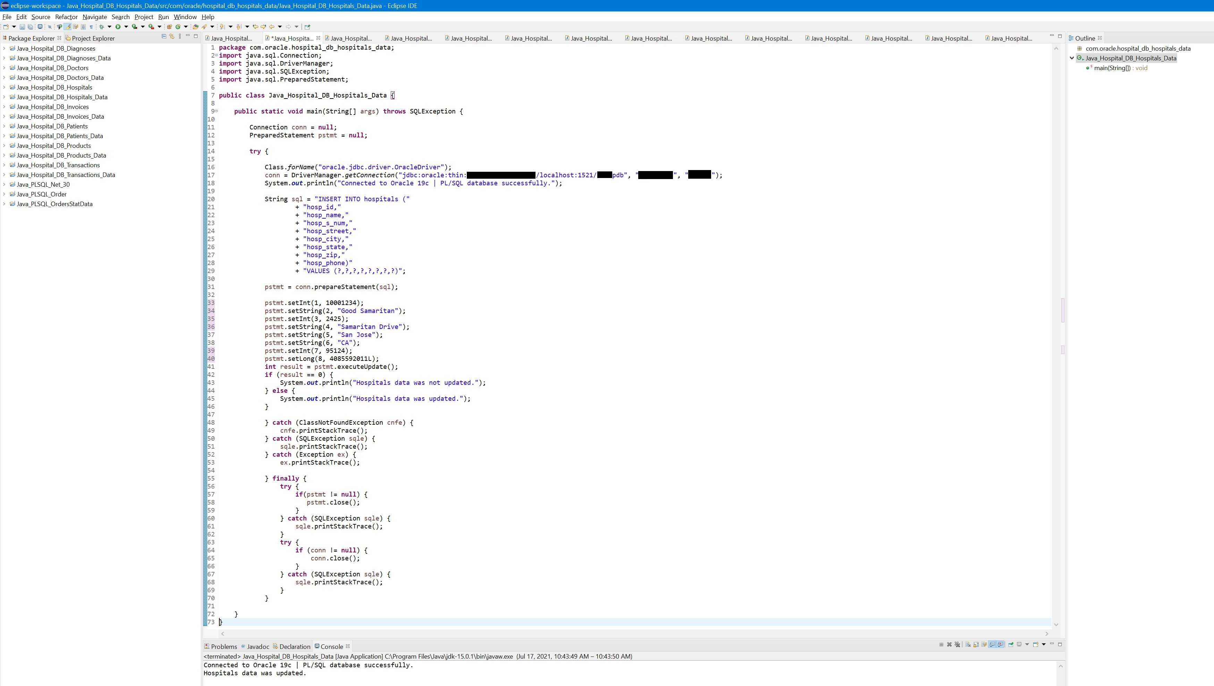
Java | JDBC | Insert PL/SQL Data 29

Slide 45
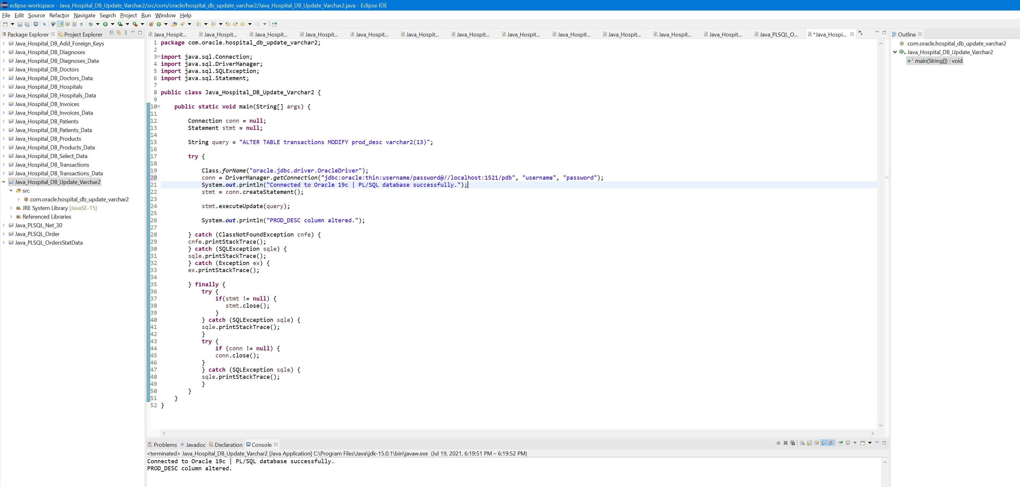
Java | JDBC | Alter Column | PL/SQL 30

Slide 46
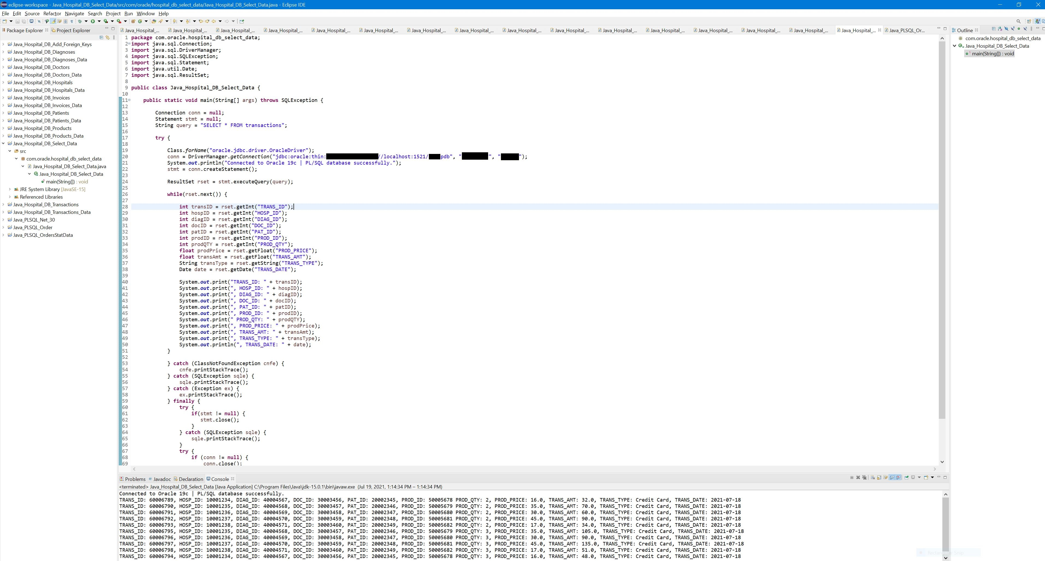
Java | JDBC | Select PL/SQL Data | Output 31

Slide 47
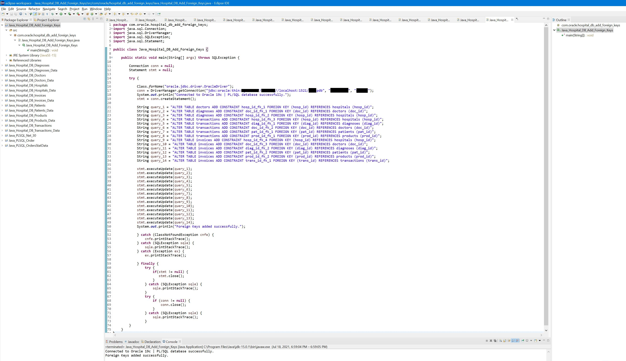
Java | JDBC | Generate PL/SQL Foreign Keys 32

Slide 48
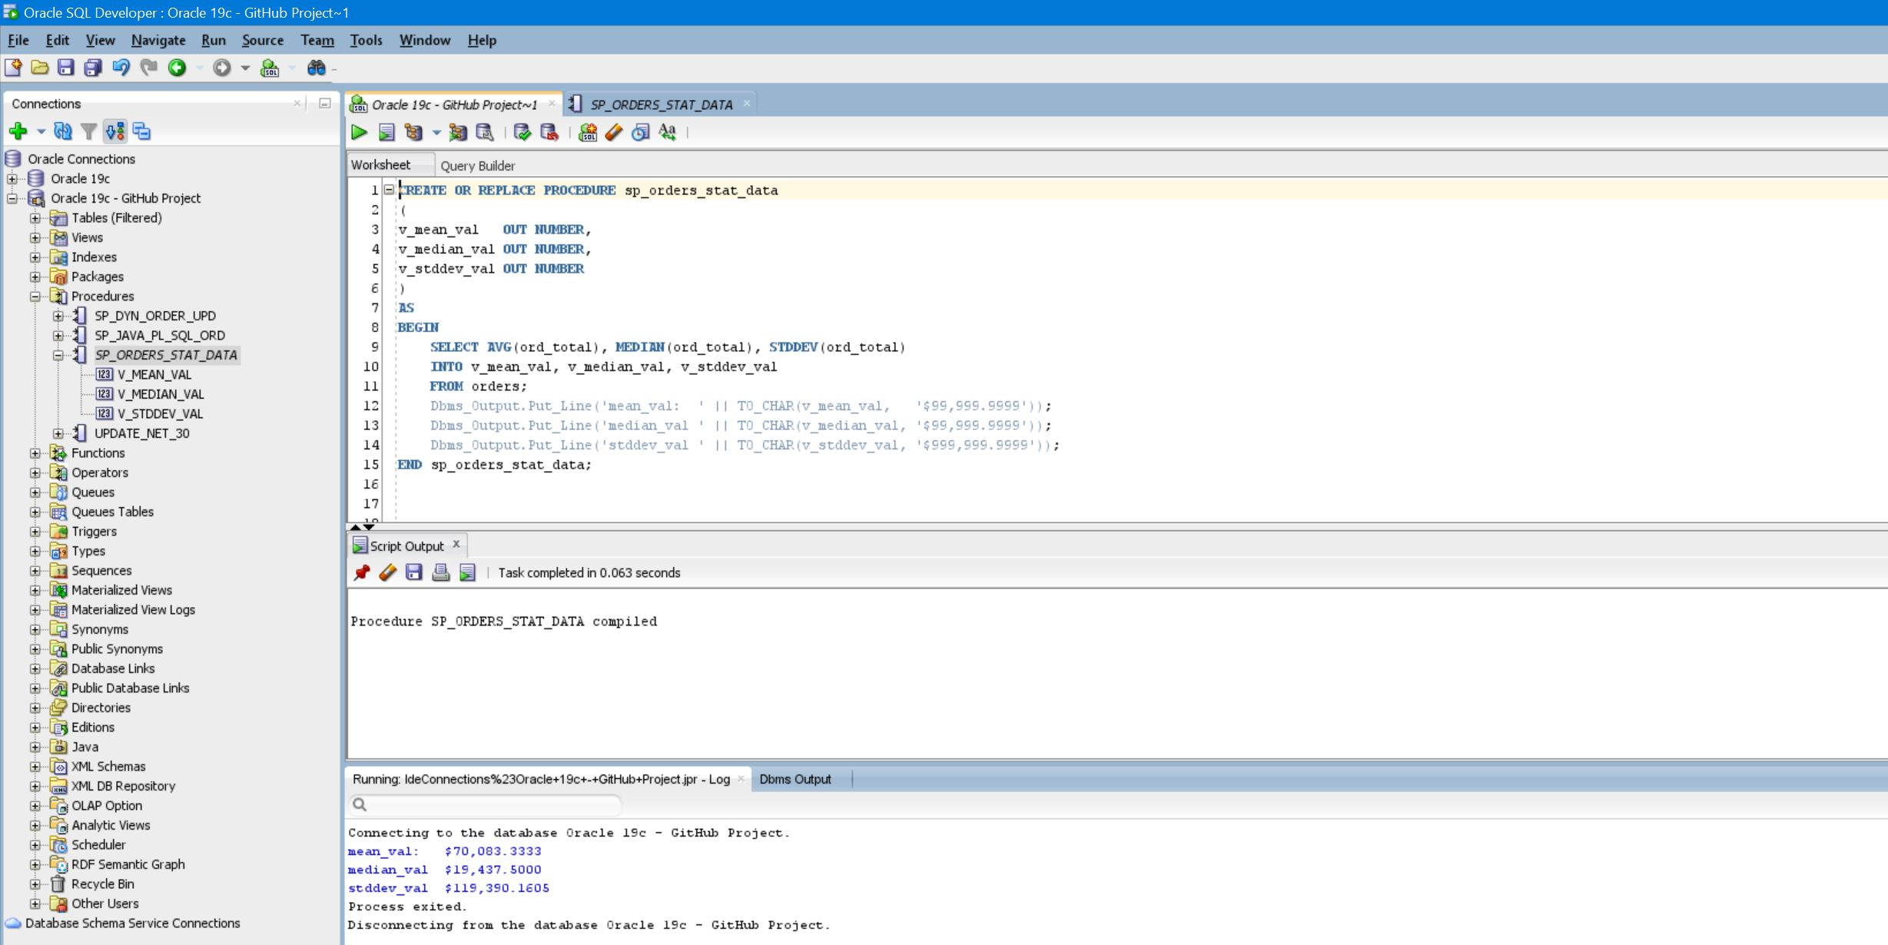
Statistical Data | Mean | Median | STDDEV 33

Slide 49
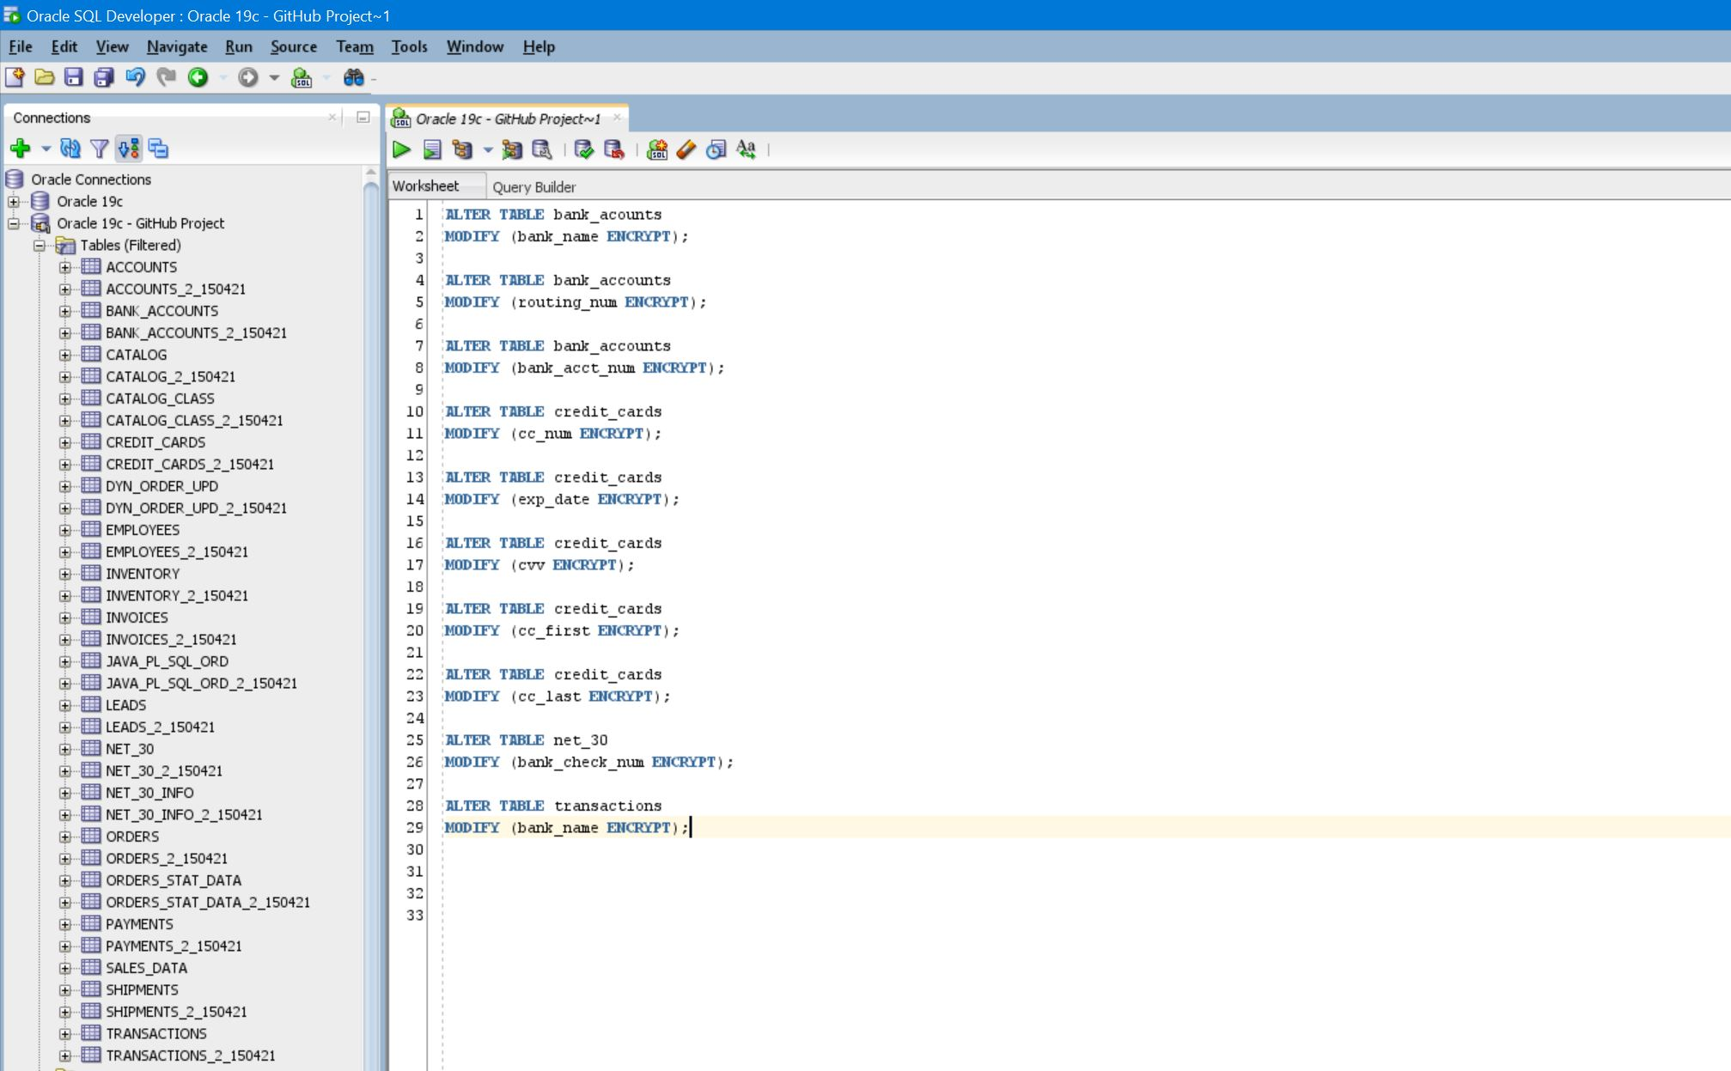
PL/SQL | AES 192 Encryption (continued) 34

Slide 50
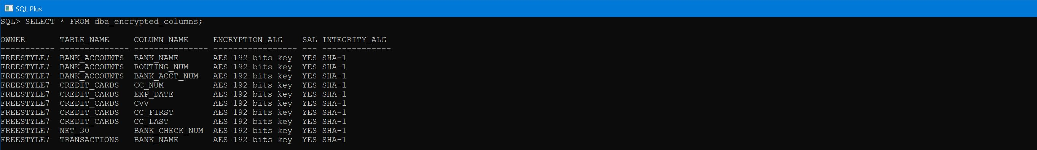
PL/SQL AES 192 Encryption 35

Slide 51
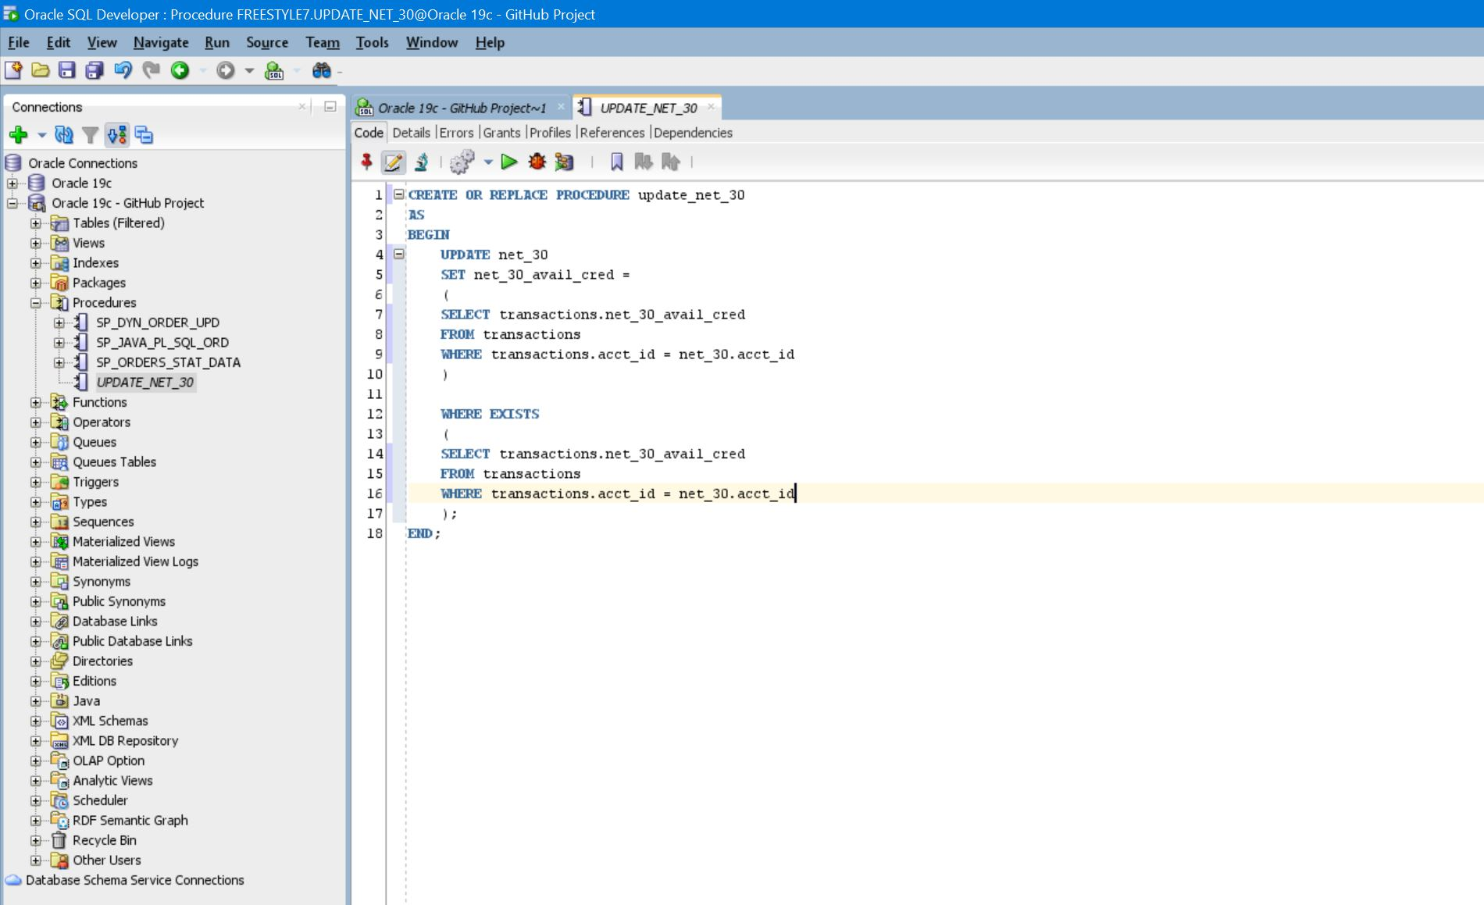
PL/SQL | DBMS_SCHEDULER | Stored Procedure (continued) 36

Slide 52
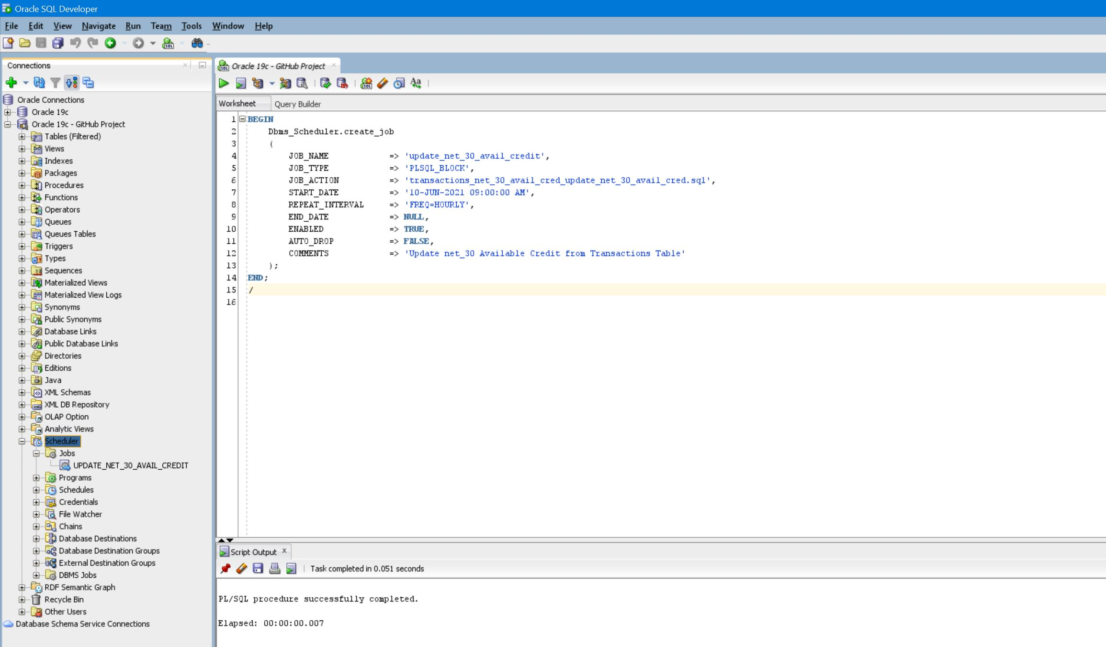
PL/SQL | DBMS_SCHEDULER | Scheduled Job (continued) 37

Slide 53
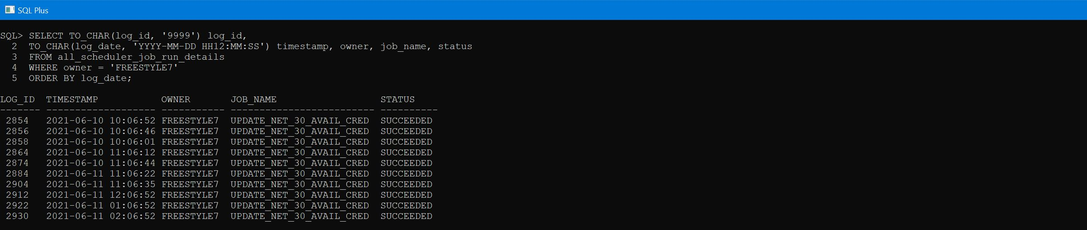
PL/SQL | DBMS_SCHEDULER | Job Details 38

Slide 54
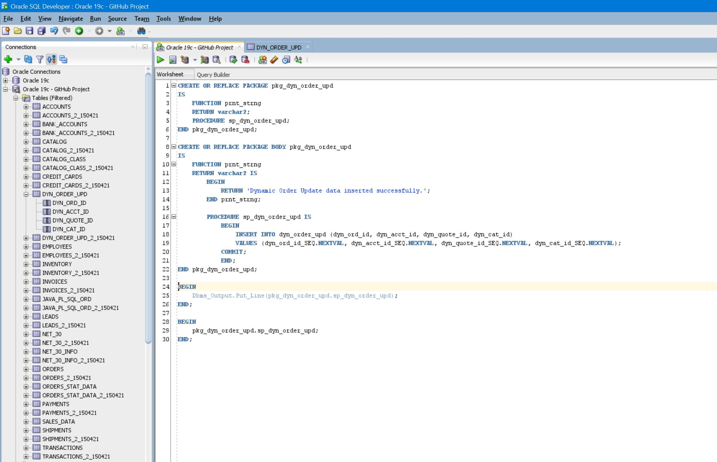
PL/SQL | Package | DYN_ORDER_UPD (continued) 39

Slide 55
PL/SQL | Package | DYN_ORDER_UPD | Output 40

